Slide 1
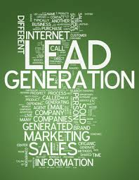
Media Antics Inc
Lead Generation (B2B- B2c)
Lead Generation Expert. For the past five years Chris has been a “go-to” expert for lead generation for both B2B - B2C.

Slide 2
Lead Generation Expert for the past five years I've been a "go-to" expert for lead generation for both B2B - B2C.
B2B Lead Generation I’ve generated leads for financial services companies, SEO firms, web design, insurance, and too many others to list here. I do this through a combination of paid advertising and highly-targeted email drops. Targeted eyeballs see those ads, powerful call to action, and revenues go up. It gets results.
B2C Lead Generation On the business to consumer side I've worked with companies that targeted business opportunities, micro franchises, private financial services, and natural health solution. Why? In the economy such as this businesses need to drive revenue, and consumers are looking for three things in any economy: make more money, look and feel better, and to truly feel loved. My goal and business to bring businesses and consumers together in a win-win situation, so it's an ideal match for everyone involved.
Business Consulting I've consulted with many different businesses from internet companies to call centers to help them strategically hire, update their training programs, and find holes in their business plans, so they can add powerful, lucrative revenue streams to their bottom line. There is a misconception in a down economy you need to downsize - the reality is your employees have been there for you, and with a couple of small tweaks you can generate more revenue, so you can be there for them so the employer-employee relationships can be successful for years to come.

Slide 3
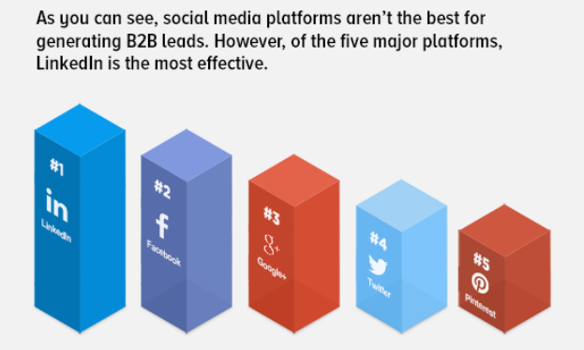
Lead Generation Success Center
Lead generation describes the actual marketing means of stimulating and capturing involvement in a product or service when considering developing product sales pipeline.
Lead generation often employs digital programs, and has become undergoing large changes lately from the actual rise connected with new on-line and social techniques. Specifically, the abundance of information easily available online has generated the rise of the “self-directed buyer” along with the emergence connected with new ways to develop and qualify possible leads just before passing these phones sales.
Your buying course of action has improved, and marketers have to find new solutions to reach buyers and acquire heard from the noise. As opposed to finding buyers with bulk advertising and email blasts, marketers should now focus on being found and discover how to build continuous relationships having buyers.
Using the growth of the internet, the entire world has changed from of details scarcity to one of details abundance. Actually, according to Google chairman Eric Schmidt “there was 5 Exabyte’s connected with information created involving the dawn connected with civilization and 2003, but that much information has become created every two days along with the pace is usually rapidly increasing”.

Slide 4
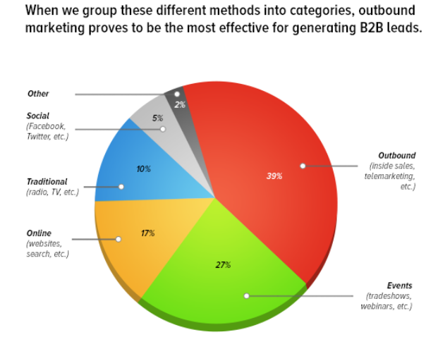
The catch is that details abundance means attention shortage. This is known as attention economics. Social scientist Herbert Simon was the primary person to debate this idea when he / she wrote “in a great information-rich planet, the riches of details means a new dearth of another thing: a shortage of whatever it's that details consumes. What details consume is pretty obvious: it consumes the eye of it is a recipient. ”
It has transformed the actual buying course of action. Buyers tend to be overwhelmed with all the noise and maybe they are getting far better and far better at overlooked the messages they don’t desire to hear and researching just what they do desire to learn about by themselves.
In the actual old planet of details scarcity, the very idea of “lead generation” intended marketing found the titles of potential buyers and passed these phones sales. Buyers expected which they will have to talk to sales and sales likely to speak to uneducated early on stage buyers that may not yet be qualified. This provides all improved. Today, buyers is able to do their unique research online which enable it to find a range of educational methods through search engines like Google, social press, and some other online programs. Through written content resources, today’s shopper can learn a great deal about a product or service before ever being forced to even talk with a salesman. So corporations must guarantee that they create their electronic presence.
Your chart beneath indicates the way significant this specific shift is usually. Both choice makers and contributors have become going out to locate you vs. you acquiring them.

Slide 5
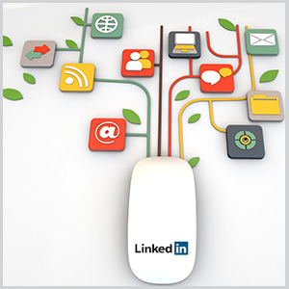
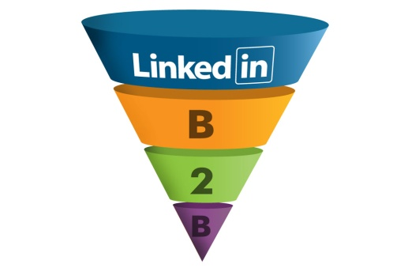
How to Use LinkedIn to Generate B2B Leads
LinkedIn is normally regarded as a new jobseeker-only social media system. As a result, B2B internet marketers at times neglect the specialist social media site’s capability to assist leads generation in addition to qualification. LinkedIn allows brand names to make available nip sizing sections involving content material in which assist organization aims.
To higher fully grasp LinkedIn’s leads generation worth; it’s helpful to fully grasp the consumption patterns.
In the beginning, LinkedIn’s primary consumption seems to be throughout the workweek across the U. S., with less action around the weekends. It is not like Twitter in addition to Zynga, which usually seem to give the majority of consumption in addition to engagement throughout the weekends.
This specific is practical since LinkedIn is intended to be a new social networking intended for user’s to remain connected with coworkers in addition to acquaintances, previous in addition to provide.
Although figures for those periods LinkedIn customers tend to be the majority of effective is usually tricky to find, social media consumption normally can increase throughout the workday concerning noon in addition to 3: 00 p. meters. Day open page looking at is usually top presently inside U. S. when men and women take a split, shop around online in addition to meet up with individuals to assist his or her organization wants. Its power being a task lookup aboard results in the tendency intended for higher site visitors throughout normal organization time.
LinkedIn is a value trove involving B2B content material which they can use to aid ones organization’s leads generation in addition to qualification routines. It requires rethinking the way you exploit this article to maximize results for your business.

Slide 6
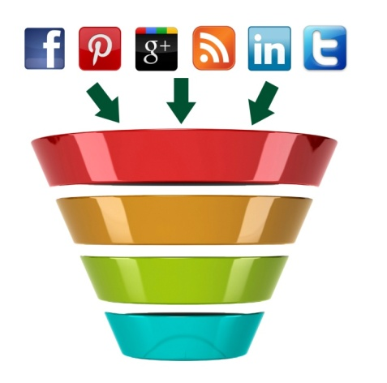
Ways that B2B Social Media Marketing Builds Brands and Generates Leads
B2B social media comes in, as it provides a method for any company, not just large multi-national corporations, to build solid brands that therefore generate quality incoming leads.
Here are four key strategies social media creates brands.
Social media can increase your current awareness. As I wrote in 5 Approaches B2B Marketing Pros Can Leverage Social media, social media lets you publish your company’s recommendations and expertise with the necessity to get past gatekeepers such as editors and traditional media. In social networking, the gatekeepers are generally your peers, and the caliber of your content as well as ideas determines just what gets promoted. Really good content is usually distributed widely – and when prospective buyers study your content fortunately they are learning about your small business and the complications you solve.
Social media can build your reputation as a thought leader. This matters because thought leadership is the best way to build your company. Buyers trust thought a leader who is able to demonstrate they realize buyer problems and how to solve them. While a trustworthiness of thought leadership can never be as “risk-reducing” as a personal referral, it is the best way to build awareness as well as increase your chances the prospect will answer future demand age group efforts.

Slide 7
Social media can encourage marketers. Word of lips is perhaps the simplest way to generate leads, since buyers trust referrals using their peers more than any other source of information. Fred Reich held and Bain know that the company with the highest Net Promoter Score in an industry typically grows a lot more than 2. 5X more rapidly than their opponents. Social media can help create promoters with three ways.
Social media can help people share the “remarkable expectation-beating experiences” they've already with your organization. This can possibly be via reviews about third-party sites (such because the sales force. com App Exchange), the responses people make to queries on LinkedIn sets of Twitter, the posts clients and prospects share all on your own community, or a number of other ways customers can connect to other prospects.
Social media will be able to create the experiences men and women want to speak about. Great content, any funny video, a handy tool – they can all be stuffs that people want to express with other prospective customers. Although this isn’t often promoting your alternative directly, there is a brand “spillover” effect giving credence to your small business.
Social media causes it to be easy to share with your site (e. gary., one click share), plus it can make the referrals more related since directly shared links originated from a trusted friend or colleague.
Social media can build your SEO ranking. Buyers tend to trust the companies with the top rankings over a Google search. Whether they comprehend the mechanics of ranking, buyers understand the wisdom of crowds is a work in determining the top rankings. Since links are the currency of ranking, social networking can play a tremendous role in building your organic rankings – both as a source of links via this article on your blog site, etc., as well so as to promote your articles and encourage other links.
The action object for marketers using this is obvious: take a lot of the budget that you would normally allocate to trade events, list purchases along with other lower-performing demand age group investments and allot it to producing great content as well as the efforts to showcase it. By having your company’s expertise on the market, you create extensive awareness and affinity for your brand, and this will likely translate into quality inbound leads generation.

